Slide 1
Lecture 8: BA Projects - Assessment, Prioritization and Execution
Prof. Mike Boyle
Department of Operations and Information Systems
University of Utah

Slide 2
Lecture Outline
Lecture:
Motivation: “Getting Serious About Analytics: Better Insights, Better Outcomes”
Terminology
Introduction: BA Project Prioritization Decision Tree
Prioritizing BA Projects and Cost/Benefit Analysis
Review: Analytics Project Prioritization Decision Tree
BA Project Execution

Slide 3
Motivation: “Getting Serious About Analytics: Better Insights, Better Outcomes”
Many organizations are not achieving their desired goals and are not recouping their investments in their analytics solutions*
* Source: McCarthy et al, “Getting Serious About Analytics: Better Insights, Better Outcomes”, Accenture (2011)

Slide 4
Terminology
Bottom-up driven initiative: Driven by the operational level; Project assessment and prioritization typically done using a business cases
Top-down driven initiative: Driven by the strategic level; Project assessment and prioritization done by strategy process using various approaches
SIPOC: Supplier, Input, Process, Output, Customer
Net Present Value (NPV): The value in the present of a sum of money, in contrast to some future value it will have when it has been invested at compound interest

Slide 5
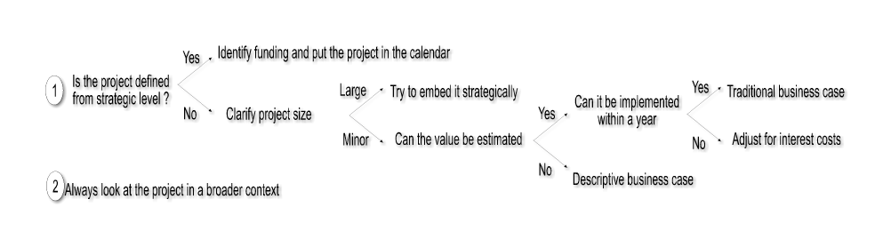
Introduction: BA Project Prioritization Decision Tree
We’ll cover the parts of the above decision tree during the lecture

Slide 6
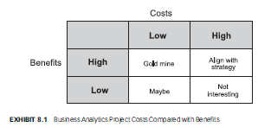
Prioritizing BA Projects: A Simple Framework
Based on:
Costs
Benefits
Supports high-level organization of BA projects
May reduce agility of company

Slide 7
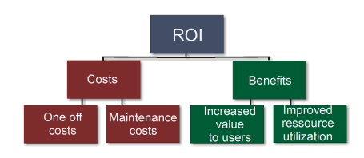
Prioritizing BA Projects: Breaking Down Costs and Benefits
1-time costs and ongoing costs
Recall: “Economic Feasibility Analysis” from DW Lecture
Value to users and improved resource utilization
Recall: “How BA Creates Value” from Introduction Lecture: 1) Efficiency gains to processes; 2) Added value to users; 3) Reduction of cognitive biases leading to better decision-making

Slide 8
Cost/Benefit Analysis: A Process Perspective
Resist looking at costs and benefits from the perspectives of:
IT Systems and Implementation Costs
General Business Benefits Gained
Concept: Examine costs and benefits the same way one looks at how BA supports a business
I.e. using a process perspective (Recall: “BA in the Organization” from Introduction Lecture)

Slide 9
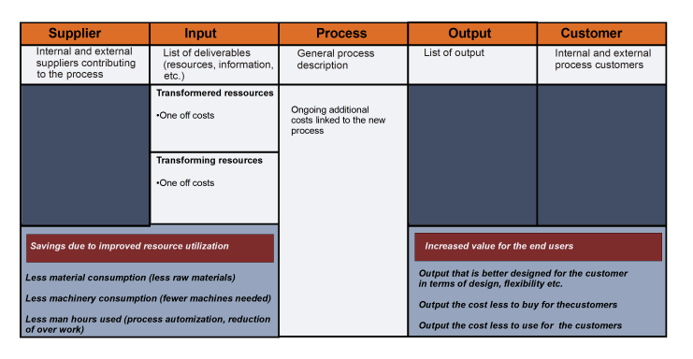
Cost/Benefit Analysis: A Process Perspective (cont’d)

Slide 10
Cost/Benefit Analysis: A Process Perspective Example
Background:
Company has many employees and is finding it difficult to retain them
There is an existing process for retention supported by BA as described on the following slide

Slide 11
Cost/Benefit Analysis: A Process Perspective Example (cont’d)
Existing process supported by BA:
As the process is, it does not drive the desired behavior around retention
Supplier: Internal and external suppliers contributing to the process | Input: List of deliverables | Process: General process description | Output: List of output | Customer: Internal and external process customers
HR BA | Transformed resource: Data | Get data Create reports Evaluate report findings | Report for decision support | HR Management
 | Transforming resource: BA Report generator

Slide 12
Cost/Benefit Analysis: A Process Perspective Example (cont’d)
(New) Proposed approach:
Use data mining to identify which employees will leave, when and when
With this information, be proactive on retention with various actions

Slide 13
Cost/Benefit Analysis: A Process Perspective Example (cont’d)
Supplier: Internal and external suppliers contributing to the process | Input: List of deliverables | Process: General process description | Output: List of output | Customer: Internal and external process customers
HR BA Finance | Transformed resource: Data | Get data Modeling Find segments Find behavior/characteristics Campaign selection Implement campaign Monitor campaign | Proactive information on who, how and when to act Process control Resource control Standard reports | HR Management People managers
 | Transforming resource: BA Report generator Data mining tool Monitoring tool
Improved resource utilization
Faster and increasingly dynamic process for identification of who to approach – less person-hours spent
Cost reduction based on fewer resignations via improved specification of who to employ, when and how
Improved user and customer satisfaction
Better working conditions results in better customer treatment

Slide 14
Cost/Benefit Analysis: A Process Perspective Example (cont’d)
How to analyze the costs and benefits of the new proposed process

Slide 15
Cost/Benefit Analysis: A Process Perspective Example (cont’d)
Several 1-time costs
Several ongoing costs
Supplier: Internal and external suppliers contributing to the process | Input: List of deliverables | Process: General process description | Output: List of output | Customer: Internal and external process customers
HR BA Finance | Transformed resource: Data | Get data Modeling Find segments Find behavior/characteristics Campaign selection Implement campaign Monitor campaign | Proactive information on who, how and when to act Process control Resource control Standard reports | HR Management People managers
 | Transforming resource: BA Report generator Data mining tool Monitoring tool
Improved resource utilization
Faster and increasingly dynamic process for identification of who to approach – less person-hours spent
Cost reduction based on fewer resignations via improved specification of who to employ, when and how
Improved user and customer satisfaction
Better working conditions results in better customer treatment
10% cost reduction
X% increase in value

Slide 16
When BA Projects Run Over Several Years: Net Present Value Analysis
Net Present Value (NPV)
Concept: Examine projects in terms of their net present value
E.g. To execute on a project, a company may need to borrow money and hence, pay interest on the loan
The cost of this loan needs to be factored in to the value of the project
E.g. To execute on a project, a company may allocate their existing funds instead of investing them elsewhere
The opportunity cost of not investing these funds elsewhere needs to be factored into the value of the project
NPV is calculated by:
Discounting all financial costs with an interest rate that cancels out capital costs
Adjusting according to the risk of the project
Execute on the project when NPV is positive
Pass on the project when NPV is negative

Slide 17
When BA Projects Run Over Several Years: Net Present Value Analysis (cont’d)
Example for Radio Station BA project:
$1M implementation costs
$4M revenue increase per year
Assume no additional costs
Risk-adjusted return requirement to the investment is 12% (provided by Finance)
NPV = Implementation Costs + Annual Cash Flow/Return Requirement
NPV = -1,000,000 + (4,000,000/0.12) = 32,300,000

Slide 18
When the Value of a BA Project is Difficult to Quantify: Qualitative Business Cases
Qualitative Business Cases have two components:
Descriptive Component
Cost-Benefit Component

Slide 19
When the Value of a BA Project is Difficult to Quantify: Qualitative Business Cases (cont’d)
Descriptive Component (Template)
Title (concise, descriptive title)
Current status (short description)
Consequences of not implementing (short description)
Critical success factors
E.g. required data can be collected
E.g. employees act on new information/knowledge
Target group (for the BA initiative)
Risk List (risk description, consequence level, likelihood level)

Slide 20
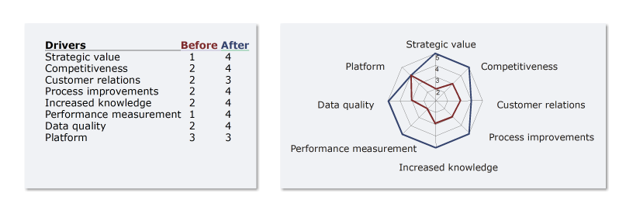
When the Value of a BA Project is Difficult to Quantify: Qualitative Business Cases (cont’d)
Cost/Benefit Component

Slide 21
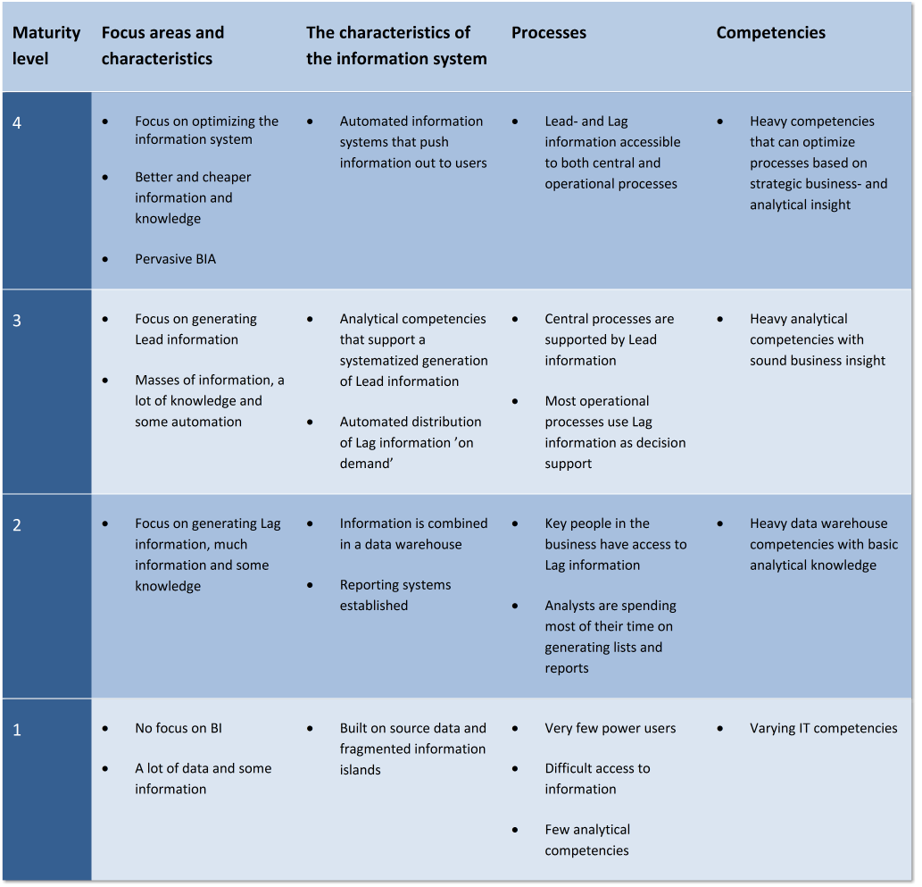
BA Project Suitability Relative to BA Maturity
Based on maturity of BA and Organization is the project right?

Slide 22
BA Project Prioritization Framework: What I Use
BA Project | Priority | Organization Goals Support | Ability to Act on Results | Potential Impact (1-5) | Level of Effort (1-5) | Additional Context
Project A | High | Goal 1 (100%) Goal 2 (50%) Goal 3 (0%) | Low: Risks are: Risk 1 Risk 2 Risk 3 | 5 | 4 | This is a high priority as the executive has already committed to it
Project B | Medium | Goal 1 (100%) Goal 2 (50%) Goal 3 (-50%) | High: Risks are: Risk 4 | 4 | 3 | It is okay to have a negative effect on Goal 3 as the positive effect on Goals 1 and 2 outweigh it
Project C | Medium | Goal 1 (50%) Goal 2 (100%) Goal 3 (100%) | Medium: Risks are: Risk 5 Risk 6 | 3 | 2 | This is a valuable project, but may not be very “exciting”
Consider adding dimension for each of the strategic positions of the company (i.e. product innovation, customer intimacy and operational excellence)

Slide 23
Review: BA Project Prioritization Decision Tree

Slide 24
BA Project Execution
Highlights: “The Secrets to Managing Business Analytics Projects”*
How experienced business analytics project managers approach their projects
They start with the assumption that the initial plan will have to change as the project progresses
They enable a process of engaging stakeholders, explaining and managing expectations
They rely on intelligent experimentation
* Source: Viaene and Van den Bunder, “The Secrets to Managing Business Analytics Projects”, MIT Sloan Management Review (2011)

Slide 25
BA Project Execution (cont’d)
Highlights: “The Secrets to Managing Business Analytics Projects”*
BA project managers most important quality categories
Delivery orientation and bias toward execution
Seeing value in use and value in learning
Working to gain commitment
Relying on intelligent experimentation
Promoting smart use of information technology
* Source: Viaene and Van den Bunder, “The Secrets to Managing Business Analytics Projects”, MIT Sloan Management Review (2011)

Slide 26
BA Project Execution (cont’d)
Highlights: “The Secrets to Managing Business Analytics Projects”*
Delivery orientation and bias toward execution
Execution bias vs. plan bias; Why?
Vision on what but not how
Technologies and/or modeling techniques to meet requirements are often unknown and/or created for purpose
Responsiveness requirement for BA projects (compared to robustness of, by comparison, software projects)
Risk management approach is focused on in-project as compared to a priori
BA Projects align with experimentation-based approaches as compared to production-oriented and/or specification-based approaches
* Source: Viaene and Van den Bunder, “The Secrets to Managing Business Analytics Projects”, MIT Sloan Management Review (2011)

Slide 27
BA Project Execution (cont’d)
Highlights: “The Secrets to Managing Business Analytics Projects”*
Seeing Value in Use and Value in Learning
With BA projects, compared to other projects:
Sticking to the plan will likely create relatively less value
Value is created incrementally during the project and at project completion
“Value in Use”: BA assets are only valuable if they are put to use
“Value in Learning”: Project team won’t guess correctly during each phase of the project. Therefore, value must be gained from the learning during each phase.
Report the value of the project in terms of “Value in Use” and “Value in Learning”
* Source: Viaene and Van den Bunder, “The Secrets to Managing Business Analytics Projects”, MIT Sloan Management Review (2011)

Slide 28
BA Project Execution (cont’d)
Highlights: “The Secrets to Managing Business Analytics Projects”*
Working to Gain Commitment
“fair process”** concept (i.e. people don’t just care about outcomes, they also care about the “fairness” of the process
Analytical models/application can directly be black boxes or sufficiently complex such that they are virtually black boxes
Objective is to get users who will act on the information and knowledge from models/application to feel comfortable
* Source: Viaene and Van den Bunder, “The Secrets to Managing Business Analytics Projects”, MIT Sloan Management Review (2011)
** Source: Kim, W, and Renée Mauborgne. "Fair process." Harvard business review (1997).

Slide 29
BA Project Execution (cont’d)
Highlights: “The Secrets to Managing Business Analytics Projects”*
Relying on Intelligent Experimentation
“…experimentation is a fundamental innovation-process activity…”**
Four-step cycle: 1) design, 2) build, 3) run, 4) analyze
Experimentation supports the “Value of Learning” concept
Practical scientific approach favored over Laboratory-style scientific approach
Just enough rigor to be meaningful and support learning
* Source: Viaene and Van den Bunder, “The Secrets to Managing Business Analytics Projects”, MIT Sloan Management Review (2011)
** Thomke, Stefan H. "Managing experimentation in the design of new products." Management Science 44.6 (1998): 743-762.

Slide 30
BA Project Execution (cont’d)
Highlights: “The Secrets to Managing Business Analytics Projects”*
Promoting Smart Use of Information Technology
“…leading companies leverage IT to revolutionize the way in which they innovate playing on four dimensions: 1) measurement, 2) experimentation, 3) sharing, 4) replication”**
Collaborate effectively with IT department as opposed to: 1) going around them or 2)waiting
Create “just enough process and infrastructure”
* Source: Viaene and Van den Bunder, “The Secrets to Managing Business Analytics Projects”, MIT Sloan Management Review (2011)
** "The 4 Ways IT Is Revolutionizing Innovation | MIT Sloan ..." 2013. 8 Oct. 2013 <http://sloanreview.mit.edu/article/it-innovation-brynjolfsson-article/>

Slide 31
Generating BA Project Concepts and Approaches
Organizations range in their ability and experience with BA
With less ability and/or experience there are BA approaches that are unknown (i.e. potential missed opportunities)
How to mitigate risks here:
Continually reassess BA Maturity Level, and:
Engage outside consultants in areas where organization can increase maturity
Use new BA projects to develop BA Maturity Level in right-sized steps

Slide 32
“Ladder” of Analytic Applications
What is the BA Maturity Level and what types of BA Applications are being executed on?
Level | Name | Description
5 | Real-time optimization | Optimal response embedded in real-time process
4 | Institutional action | Prediction and differentiated action embedded in process
3 | Predictive action | Predictions of response by key target/segment
2 | Differentiated action | Different approached for different key targets/segments
1 | Key targets/segment | Key targets and/or segments defined
0 | Data in order | Well-defined, common, clean, integrated data
Source: Davenport et al, “Analytics at Work” Harvard Business Press, 2010, p. 83

Slide 33
BA Project Retrospective Framework
Look for:
Logic errors
Not asking the right questions
Making incorrect assumptions and failing to test them
Using analytics to justify what you want
Failing to take the time to: 1) consider all/most alternatives and/or 2) interpret the data correctly
Process errors:
Data entry errors
Failing to consider alternatives seriously
Using incorrect or insufficient decision-making criteria
Delivering results too late
Postponing decisions for “another round of analysis”
Source: Davenport et al, “Analytics at Work” Harvard Business Press, 2010, p. 13

Slide 34
Appendix

Slide 35
TODOs
Review and light updates
(see inline TODOs)

